Slide 1
Marketing Mix Model Training
Session 5
Data Upload and Model Setup

Slide 2
Agenda
Do’s and Dont’s for Data upload - DDE
Project Calendar Creation
Input Module - DDE
Data Classification
Model Transformations
Model Validations

Slide 3
“Do’s and Dont’s for the file upload
The data file has to be in xls or xlsx format
No special characters in measure names and measure values
No blank rows and No blank columns
File should contain Time Period, Dimension(s) and KPI (Dependent) as mandatory columns
Demand Drivers will always consider the first sheet of excel file that is uploaded
There should not be any hidden sheets in the excel file
There should not be any formulae in the excel file
The variable name should not be more than 32 characters
No duplicate measure names are allowed

Slide 4
Project Calendar
A typical output would require breaking the time into multiple periods like weekly, monthly, quarterly and yearly.
It is important to know the mapping of each day into corresponding day, month, quarter and year to be able to perform like to like comparison between current period and previous periods.
Project calendar setup ensures that the user is providing the mapping prior to loading the dataset.

Slide 5
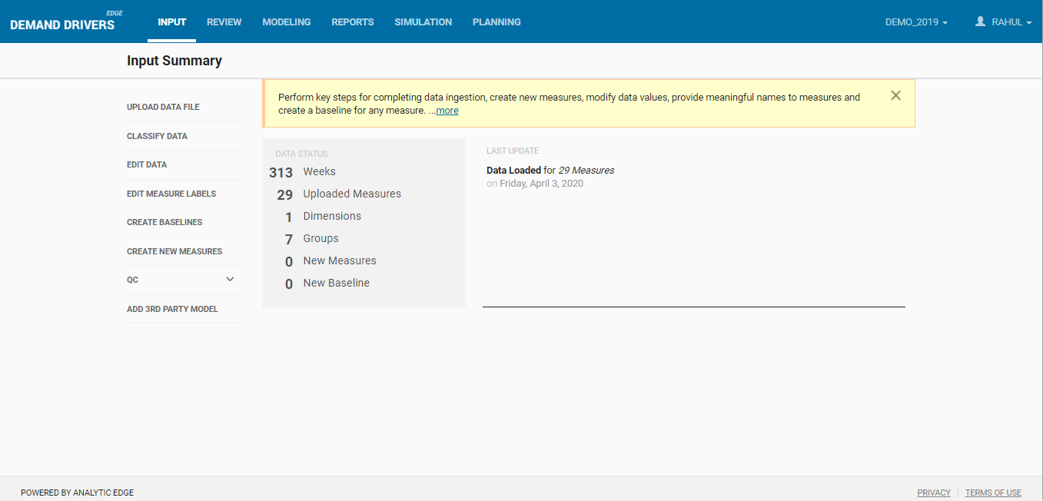
Input Module
The following sections in this module help to prepare data as required
Upload Data Files
Classify Data
Edit Data
Edit Measure Labels
Create New Measures
Edit Transformations

Slide 6
Data Classification
In this section, User can classify the measures into relevant groups such as Baseline, Incremental, etc.
Classification consists of Dimension, Dependent Variable, Base, Price, Media, Trade and Time.
Dimension - includes Brand and Channel
Dependent Variable - defines the Dependent Variable being modelled
Time includes week ending, date range
Base is selected for the column whose outcome may vary each time; it includes Seasonality, Index, Average item per store, Points and distribution
Price includes Average and base equivalence price
Media is selected for the columns which are affected by media variables such as TV, Print, Digitals, Paid search prints and online ads
Trade – is selected for Any in-store promotions like Display, Feature and Price reductions

Slide 7
Model Transformation
The transformations are documented in the marketing science literature and widely used across clients. Following are a few in-built transformations in DDE:
Direct – “Direct” indicates the measure will be used as is in the model without any transformation.
Log – “Log” indicates the natural log of the measure will be used in the model.
Lag – “Lag” indicates the lagged values of the measure will be used in the model. Lag transformation expects user to provide the periodicity to take the lag i.e. one input parameter. If the time is in weeks, user has to provide the number of weeks by which the measure will be lagged.
Moving Average – It indicates moving average values of the measure will be used in the model. It takes one input parameter i.e. Period and the value should be greater than 0.
Ad-Stock – Ad-Stock takes one input parameters viz. Decay. Decay parameter takes values between 0 and 1 and the standard values used are 0.1, 0.2, ---- 0.9. Decay parameter value of 0.1 means 10% of the impact of advertisement is observed during the time of execution

Slide 8
Why do we need to do Correlation analysis?
Before modeling, check correlations between independent variables and volume.
Higher the correlation, more is the influence of the independent variable on dependent variable volume
If the variable is very important for the client and the correlation coefficient is counter intuitive, transformations usually come to rescue.
In case of a very high correlation between 2 independent drivers, it indicates the possibility of multicollinearity in the model; we should assess whether to include both these drivers in the model
Analytic Edge Proprietary and Confidential

Slide 9
Summary sheet setup & Key Outputs
Model Fit : Depicts the Trend between the actual and Predicted Sales
Elasticity can be defined as the percent change in total volumes with a unit percent change in the driver.
Volume Contribution/Decomposition : Contribution is defined as the incremental sales incurred due to the presence of a particular driver (Eg – Media and Trade Drivers)
Due-to’s : The difference in Contribution for a particular driver with respect to the same time period year ago. Usually represented as Percentage.

Slide 10
Model Validation
Face validity criteria are:
Data transformations based on mental models and adhering to global best practices
Correct signs on coefficients
Elasticities or volume response rates within reasonable ranges
competitive effects within reasonable ranges
Volume contributions within reasonable ranges
Change to year ago due to errors of reasonable size
Minimal use of dummy variables and trend terms
Statistical validity criteria are:
Low MAPEs
High R2
Alignment of predicted to actual, no odd jumps or 0s in predicted volume

